Slide 1

Industrial Copper Modeling
Kanimozhi Sureshkumar

Slide 2

Agenda
Introduction
Dataset & Libraries
Project Learning
Import Libraries
Requirements
Methodology
Conclusion

Slide 3


Introduction
Copper is a reddish-gold metal and chemical element with the symbol Cu. Copper has many uses including: Construction, Electrical equipment, Engineering, Industrial machinery, Coins, Gun metals, and Architecture.
The Industrial Copper Modeling project focuses on predicting the selling price and status (won or lost) in the industrial copper market using machine learning regression and classification algorithms. By exploring the dataset, performing data cleaning and preprocessing, and applying various machine learning techniques, we aim to develop models that can accurately predict the selling price and status in the copper market.

Slide 4
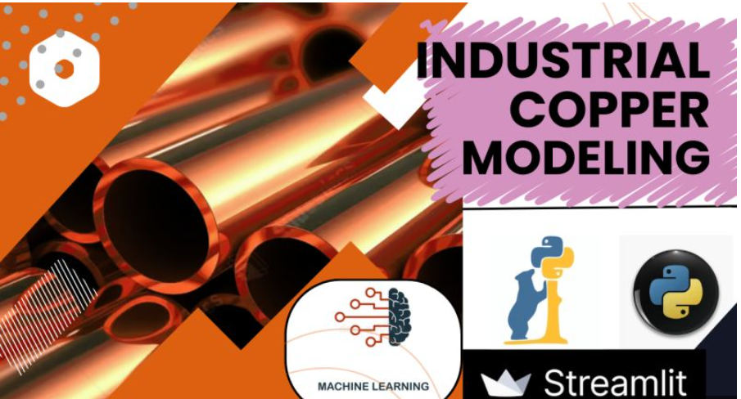
Dataset
The dataset used for this analysis contains information about industrial copper transactions, including variables such as selling price, quantities,
material_ref, delivery date and status (won or lost).
It provides a comprehensive view of the copper market and factors that influence the outcomes of transactions.

Slide 5
Project Learnings
The main learnings from this project are as follows:
Exploring Skewness and Outliers: Analyze the distribution of variables in the dataset and identify skewness and outliers. This step helps in understanding the data quality and potential issues that may affect the model performance.
Data Transformation and Cleaning: Transform the data into a suitable format for analysis and perform necessary cleaning steps. This includes handling missing values, encoding categorical variables, and scaling numerical features.
Machine Learning Regression Algorithms: Apply various machine learning regression algorithms to predict the selling price of industrial copper. Compare the performance of algorithms such as linear regression, decision trees, random forests.
Machine Learning Classification Algorithms: Apply different machine learning classification algorithms to predict the status (won or lost) of copper transactions.
Evaluation and Model Selection: Evaluate the performance of regression and classification models using appropriate metrics such as mean squared error (MSE), accuracy, precision, and recall. Select the best-performing models based on these metrics

Slide 6
Requirements
To run this project, the following libraries are needed:
NumPy: A library for numerical computations in Python.
Pandas: A library for data manipulation and analysis.
Scikit-learn: A machine learning library that provides various regression and classification algorithms.
Matplotlib: A plotting library for creating visualizations.
Seaborn: A data visualization library built on top of Matplotlib.
Make sure these libraries are installed in your Python environment before running the project.

Slide 7
Methodology
Data loading: load the industrial copper dataset into the code using pandas library. Perform initial data exploration to understand the structure and content of the dataset.
Data cleaning and preprocessing: handle missing values, remove outliers if necessary, and perform necessary data transformations such as encoding categorical variables. This step ensures the data is in a suitable format for analysis.
Exploratory data analysis (eda): use pandas, matplotlib, and seaborn libraries to explore the dataset. Analyze different variables, their distributions, and relationships. Generate visualizations such as histograms, scatter plots, or box plots to gain insights into the data.
Machine learning regression: apply various machine learning regression algorithms to predict the selling price of industrial copper. Split the dataset into training and testing sets, train the models, and evaluate their performance using metrics such as mean squared error (MSE).

Slide 8
Countiued….
Machine learning classification: Apply different machine learning classification algorithms to predict the status (won or lost) of copper transactions. Split the dataset into training and testing sets, train the models, and evaluate their performance using metrics such as accuracy, precision, and recall.
Documentation: prepare a comprehensive documentation summarizing the steps involved in the analysis, including the preprocessing techniques, machine learning algorithms used, and their performance. Include visualizations and interpretations to effectively communicate the results.

Slide 9
Conclusion
The Industrial Copper Modeling project aims to predict the selling price and status in the industrial copper market using machine learning techniques.
Video Link:
Githublink: https://github.com/kanis11/IndustrialCopperModeling
Video link: https://www.linkedin.com/feed/update/urn:li:activity:7236606735736586240/

Slide 10

Thank you
Kanimozhi Sureshkumar

